Slide 1
Family Research and Genealogy at The Wiener Holocaust Library
28 July 2020
Elise Bath
Senior ITS Archive Researcher

Slide 2
The Wiener Holocaust Library’s offering during the Corona Virus
Partial re-opening of The Wiener Holocaust Library https://wienerlibrary.co.uk/Blog?item=449&returnoffset=0
Online Resources
Library catalogue available through our website
‘The Holocaust Explained’ an online teaching resource
‘Pogrom 1938: Testimonies from Kristallnacht’
‘Refugee Family Papers: An Interactive Map
More information here: https://www.wienerlibrary.co.uk/Blog?item=434&returnoffset=10

Slide 3
Family Research during the Corona Virus
International Tracing Service Archive (ITS):
Over 30 million documents from the time of the Holocaust and the immediate post war period that relate to the experiences of over 17.5 million people
The physical archive is in Bad Arolsen, Germany and is called the Arolsen Archives
Various countries have a digital copy of the archive: The Wiener Holocaust Library has the UK’s copy of this archive
Used at the Library for academic research and family tracing
In 2020 so far we have traced the experiences of 245 individuals caught up in the Holocaust; very high demand

Slide 4
Accessing the ITS Archive
Submit a research request via our website: https://www.wienerlibrary.co.uk/its
Access the material online via the Online Archive: https://collections.arolsen-archives.org/en/search/
NB. This version of the archive is not complete, it contains about 26 million of the over 30 million documents available. However, it is still a huge and useful resource.

Slide 5
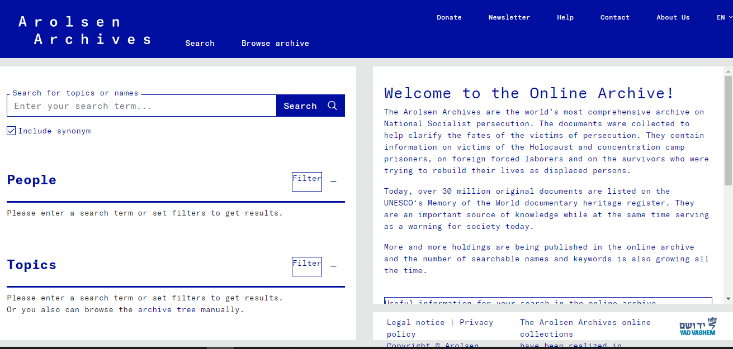
Using the Online Archive

Slide 6
3) The documents and background information will appear here
1) Enter search term here
2) Search results appear here; click on the result you are interested in

Slide 7
Understanding the Online Archive
Many of the documents held in the Online Archive contain codes or terms which are difficult to understand without guidance. Arolsen Archive has created an E-guide to help decode and explain these documents in the online archive : https://eguide.arolsen-archives.org/en/
This is a rich resource which contains a huge amount of information about the documents in the Online Archive. It really rewards exploration: clicking through the various documents and the different sections reveals a wealth of details about these records.

Slide 8
Home page of the E-Guide

Slide 9
Using the E-Guide
Select English or German language here
Select ‘Concentration Camp’ or ‘Displaced Persons’ documents (leave blank for both)

Slide 10
Home page of the E-Guide
To search for a document:
Click the magnifying glass icon at top right and type in a search term e.g. ‘prisoner card’ or ‘Buchenwald’
OR
Scroll down through the images of the documents and click on the one you’re interested in

